Slide 1
Notes and Tips for CMPEN331 Final Project
Final Project Bonus: Control Transfer
Slides compiled by Andrew Jones
Notes:
For students looking at these slides in the future, these notes were used as a script :) Hello everyone, My name is Andrew Jones and I'm one of the LAs for Computer Engineering three thirty one at Penn State. This is the notes, hints, and tips video for the final project bonus.

Slide 2
Welcome, Students!
If you are a student of CMPEN331 going through these slides, welcome!
If you haven’t already, please go watch the video. These slides are meant to supplement the video, which contains information that may not be present in these slides.
Feel free to use these slides as reference as you work on your Final Project.

Slide 3
Some Starting Notes
If you’re here, welcome!
If you haven’t already, go watch the video for the non-bonus final project
This video assumes you have at least watched through the parts about modifications from lab 5
You don’t need to watch the implementation part, once you reach there, you can skip straight to this video
When submitting, you only need to make one submission of just the bonus.
You do not need to make a separate submission for the non-bonus portion, just submit only the bonus.
Notes:
If you’ve managed to complete the base final project and are ready to do the bonus, welcome! If you haven’t done so already, you’ll need to watch the video for the non-bonus portion of the final project before watching this one. Once you get to the part in the video talking about implementation, you can skip straight to this video. I mention in the non-bonus video when this point is, so you’ll know exactly when to jump to here. In addition, when you submit your final project, you only need to submit the bonus portion of it. You do not need to make two separate submissions with one being the non-bonus and the other being the bonus, you can just submit only the bonus.

Slide 4
What exactly are we doing in labs 3 through 5 + final project?
Labs 3 through 5, along with the final project, consists of implementing different stages/features of our five stage MIPS pipeline. The main structure of the five stages will be implemented through the labs, and the final polish and functionality will be implemented in the final project. There is also a bonus for the final project that implements additional instructions.
The bonus on final project is extra credit, I highly recommend that all of you try the bonus if you have time.
Lab 3: Stages 1 and 2 (Instruction Fetch, Instruction Decode)
Lab 4: Stages 3 and 4 (Execution, Memory Access)
Lab 5: Stage 5 (Writeback)
Final Project: Forwarding Behavior
Final Project Bonus: Control Transfer Instruction Implementation (branch/jump instructions).
Notes:
Now that our pipeline is correctly functioning for the six instructions we’ve implemented so far, we can go ahead and implement control transfer instructions, as well as a couple other useful instructions.

Slide 5
Overview of Final Project Bonus
Control Transfer Instructions
Extra Instructions
Control Unit will be modified to handle branch and jump instructions
This will also require the modification and addition of some other modules
Once we’ve implemented Control Transfer Instructions, we’ll add a couple extra useful instructions
In total, you will have 20 instructions that can be executed
Notes:
To implement our control transfer instructions, we will modify the control unit to process the correct control signals to execute the control transfer instructions. This will require the modification and addition of some other modules, which I’ll talk about in these slides. We’ll also be implementing a few more instructions that will be of use alongside these control transfer instructions. In total, we will have 20 instructions that can be executed.

Slide 6
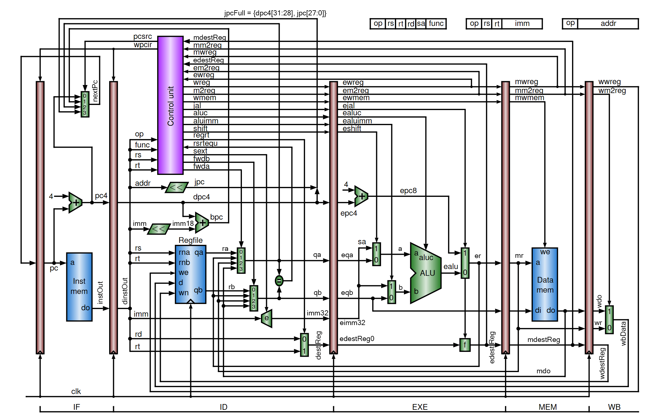
Diagram for Final Project Bonus
Notes:
Here is the diagram for the final project bonus. Now, I’m not going to go into a lot of detail about these modules and their functionality like I usually do, but I’ll explain what modules here are new or changed, as well as their functionality to the point where you should be able to understand what’s going on in the pipeline. As always, the slides for this presentation will be made available on Canvas

Slide 7
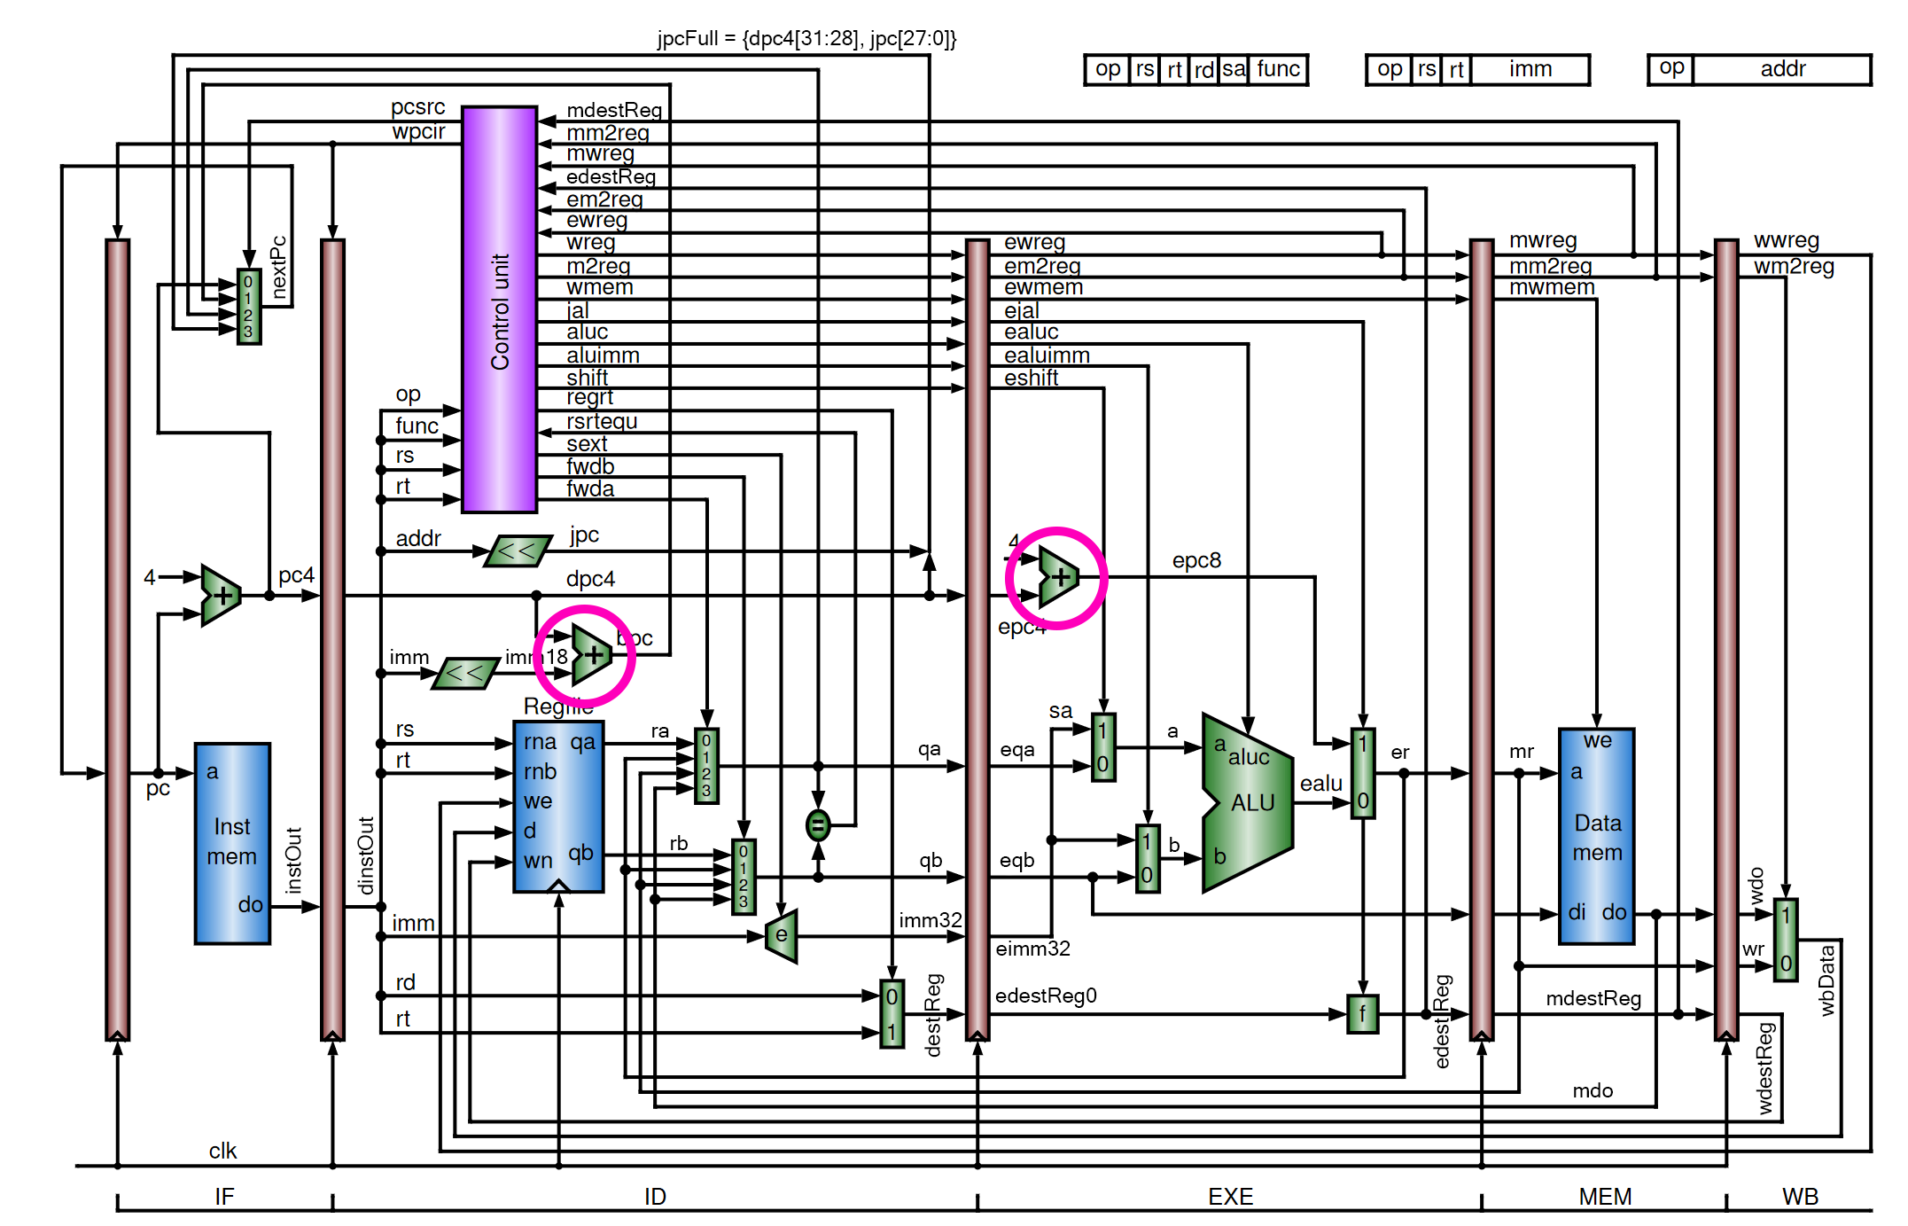
New Adders
Notes:
In our final implementation, we’ll have two new adders in our datapath. All inputs and outputs are 32-bits wide for these modules, and the output is simply the addition of the inputs. The leftmost adder calculates the next PC value when a branch instruction is executed, and the rightmost one adds four to the pc4 signal, which is used for JALR instructions.

Slide 8
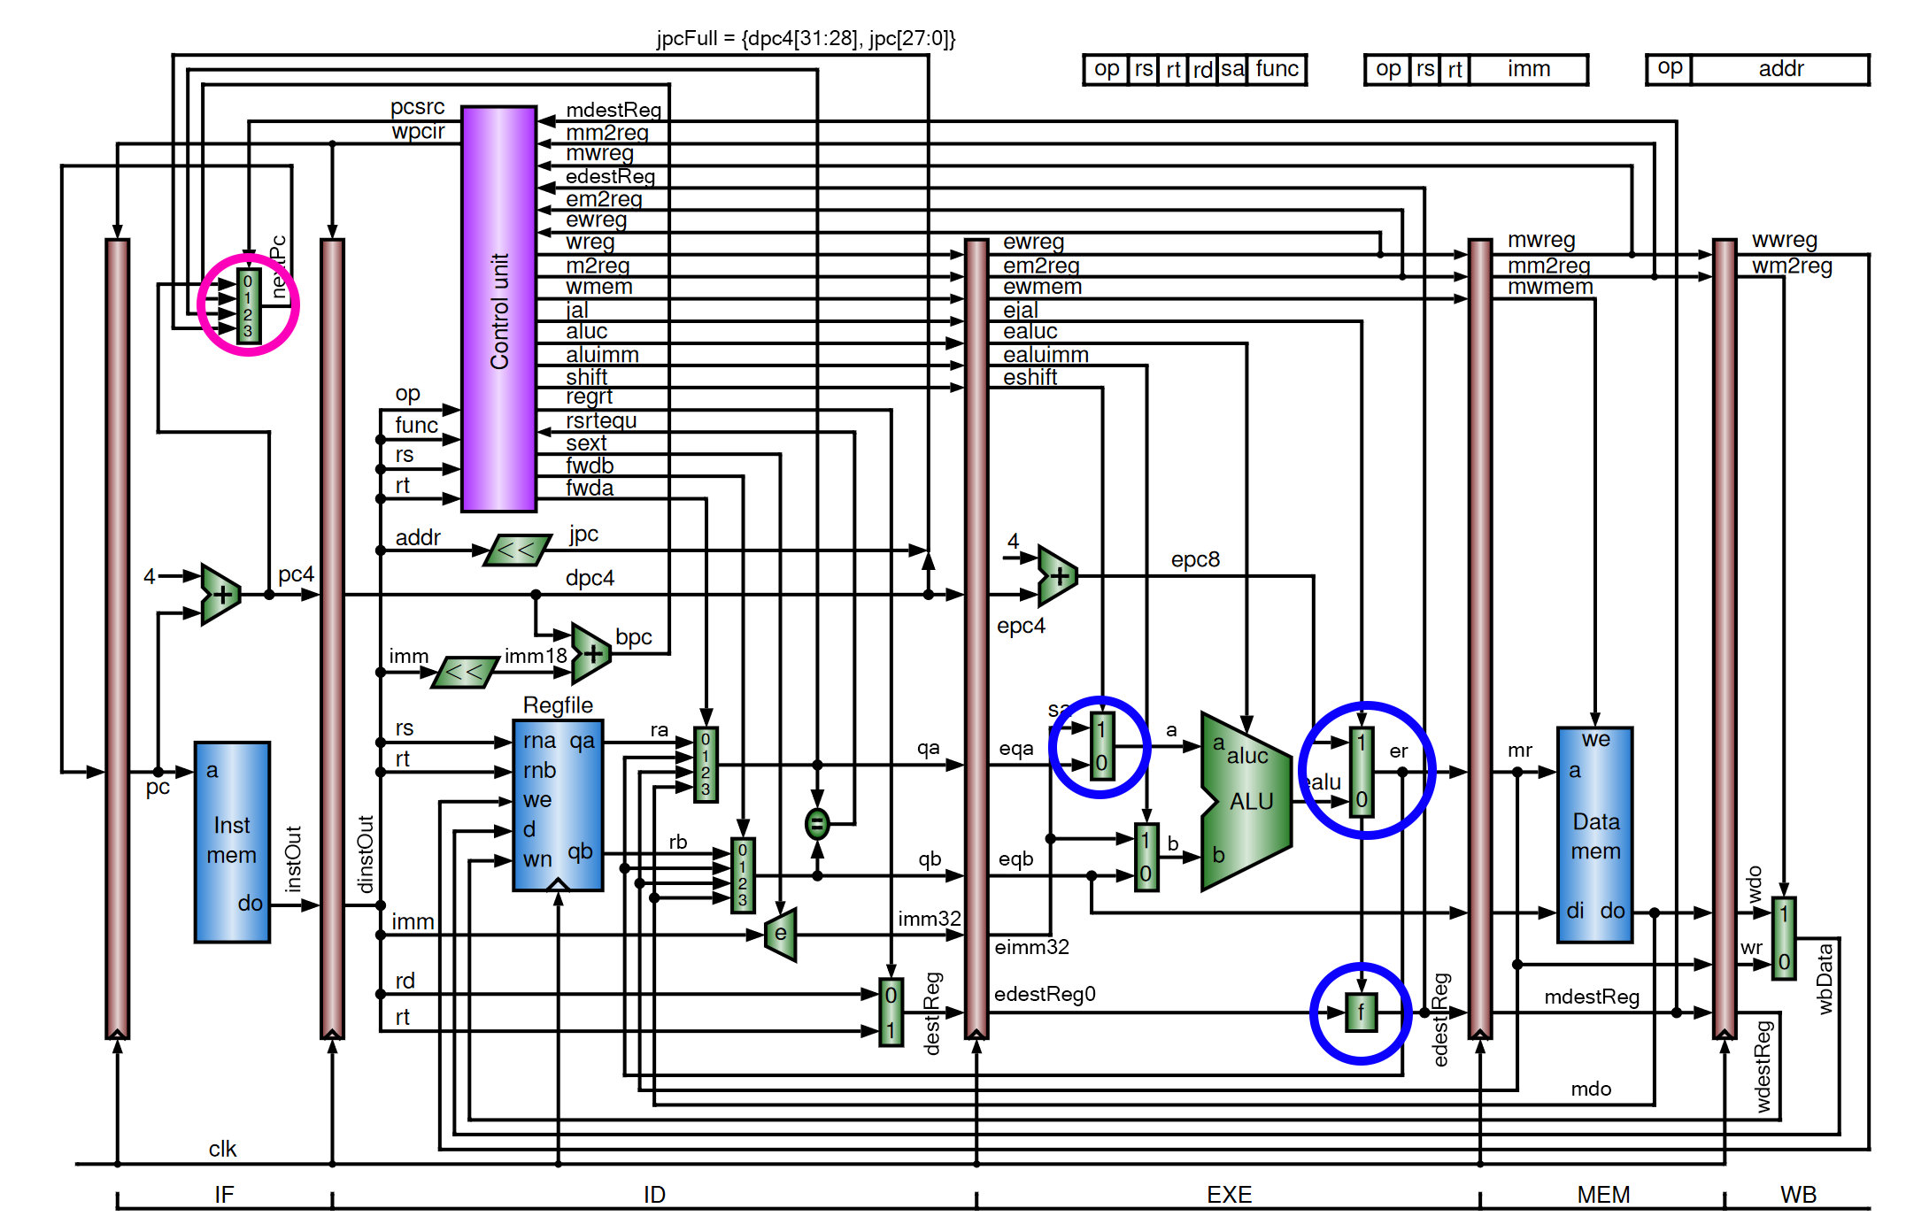
New Multiplexers
Notes:
Next, we’ll have four new multiplexers. One of these will be a 4 to 1 multiplexer, which is used for selecting the next PC value, while the other three will be 2 to 1 multiplexers. The leftmost 2 to 1 multiplexer is used for shift instructions, the rightmost one connected to the ALU is used for selecting pc8 for JALR instructions, and the bottom-most multiplexer labelled f is used for setting the destination register to 31, which is also used for JALR instructions. All of these muxes, except for the 2 to 1 multiplexer at the bottom labelled “f” will has 32-bit inputs and outputs, with the exception of the selector bits. The multiplexer labelled “f” will have 5-bit inputs and outputs. For this multiplexer, if the selector bit ejal is 0, the output is edestReg0. If ejal is 1, the output of this mux is all 1s.

Slide 9
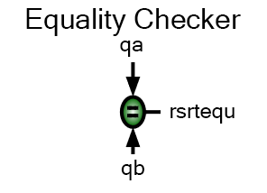
Equality Checker
Inputs:
qa [32 bits]
Output:
rsrtequ [1 bit]
Functionality: on any signal change
if qa and qb are equal, rsrtequ is 1
qb [32 bits]
otherwise, rsrtequ is 0
Notes:
Next is our equality checker. This module simply takes in the 32-bit values of qa and qb, and outputs one on rsrtequ if qa and qb are equal. If qa and qb aren’t equal, rsrtequ is zero. This module is used for choosing whether or not to take branches on BEQ and BNE instructions.

Slide 10
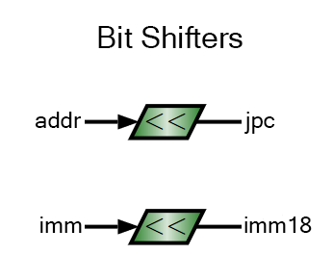
Bit Shifters
Inputs:
addr [30 bits]
Output:
jpc [32 bits]
Functionality: on any signal change
input is shifted left 2 bits
imm [30 bits]
Note these are two separate modules
Their functionality, however, is the same
imm18 [32 bits]
note addr is 26 bits wide in datapath, must be zero-extended to 30 bits
note imm is 16 bits wide in datapath, must be zero-extended to 30 bits
Notes:
Next is our bit shifters. These are used in calculating PC values for control transfer instructions. These simply take the input and shift it left two bits. Note that addr and imm in the datapath need to be zero-extended to 30 bits for these modules. The easiest way to do this is through concatenating a zero value of the necessary width with the input signal in the datapath

Slide 11
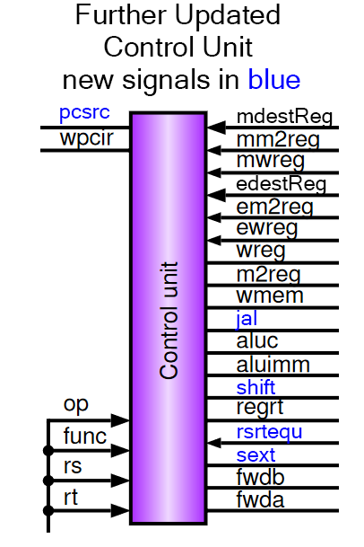
Even More Updated Control Unit
New Inputs:
rsrtequ [1 bit]
New Outputs:
New Functionality will be described on next slide
shift [1 bit]
sext [1 bit]
jal [1 bit]
pcsrc [2 bits]
Notes:
Next, I’ll talk about the changes to our control unit. Note that this assumes you’ve completed all the changes to the control unit in the non-bonus portion.

Slide 12
A bit more on the new logic in Control Unit
Even More Instructions :D
We will be adding the following instructions to our control unit:
SLL (shift left logical)
SRL (shift right logical)
SRA (shift right arithmetic)
JR (jump register/jump return)
ADDI (add immediate)
ANDI (and immediate)
ORI (or immediate)
XORI (xor immediate)
SW (store word)
BEQ (branch if equal)
BNE (branch if not equal)
LUI (load upper immediate)
J (jump)
JAL (jump and link)
You’ll need to figure out the control signals for these instructions on your own. You should be able to derive these control signals by understanding what each instruction is doing, and how it should affect the execution of the instruction within the CPU.
New Control Signals:
jal: if we’re executing a jump and link instruction, this is 1. Otherwise, this is 0.
shift: if we’re executing a shift instruction (SLL, SRL, or SRA), this is 1. Otherwise, this is 0.
sext: stands for sign extension, should be 0 when executing ANDI, ORI, XORI, or LUI. For all other instructions, this should be 1.
pcsrc: selects the value of the next PC. Should be:
2 if JR instruction
3 if J or JAL instruction
1 if BEQ instruction and rsrtequ is 1 OR if BNE instruction and rsrtequ is 0
if BEQ instruction and rsrtequ is 0 OR if BNE instruction and rsrtequ is 1, then pcsrc should be 0
0 for all other instructions
Initial Values
You’ll want to set pcsrc to 0 in an initial block

Slide 13
Changes to other modules
ALU
Your ALU should be modified to support shift instructions, as well as the LUI instruction
You will need to add the aluc signals to the control unit as well
Immediate Extender
The immediate extender should take in a new input, sext (this stands for sign-extension)
If sext is 1, sign extend the immediate as before.
If sext is 0, then zero extend the immediate.
Instruction Memory
Instruction memory will have 35 new instructions.
These will be defined in the project document on pages 5 and 6.

Slide 14
Changes to other modules from Lab 5
Data Memory
Data Memory will have new default values as well
These will also be defined in the project document on page 6.
Pipeline Registers
Some of the pipeline registers will need to pass additional signals through them
Use the diagram as a reference for this. This should be trivial to implement
Datapath
Your Datapath needs to initialize the new modules, and connect all the new and modified signals/wires
This is the part students make the most mistakes on, so take your time and double-check every wire you’re changing here. Use the diagram as a reference!
Testbench
Testbench will have no changes, use the same testbench you used for lab 5

Slide 15
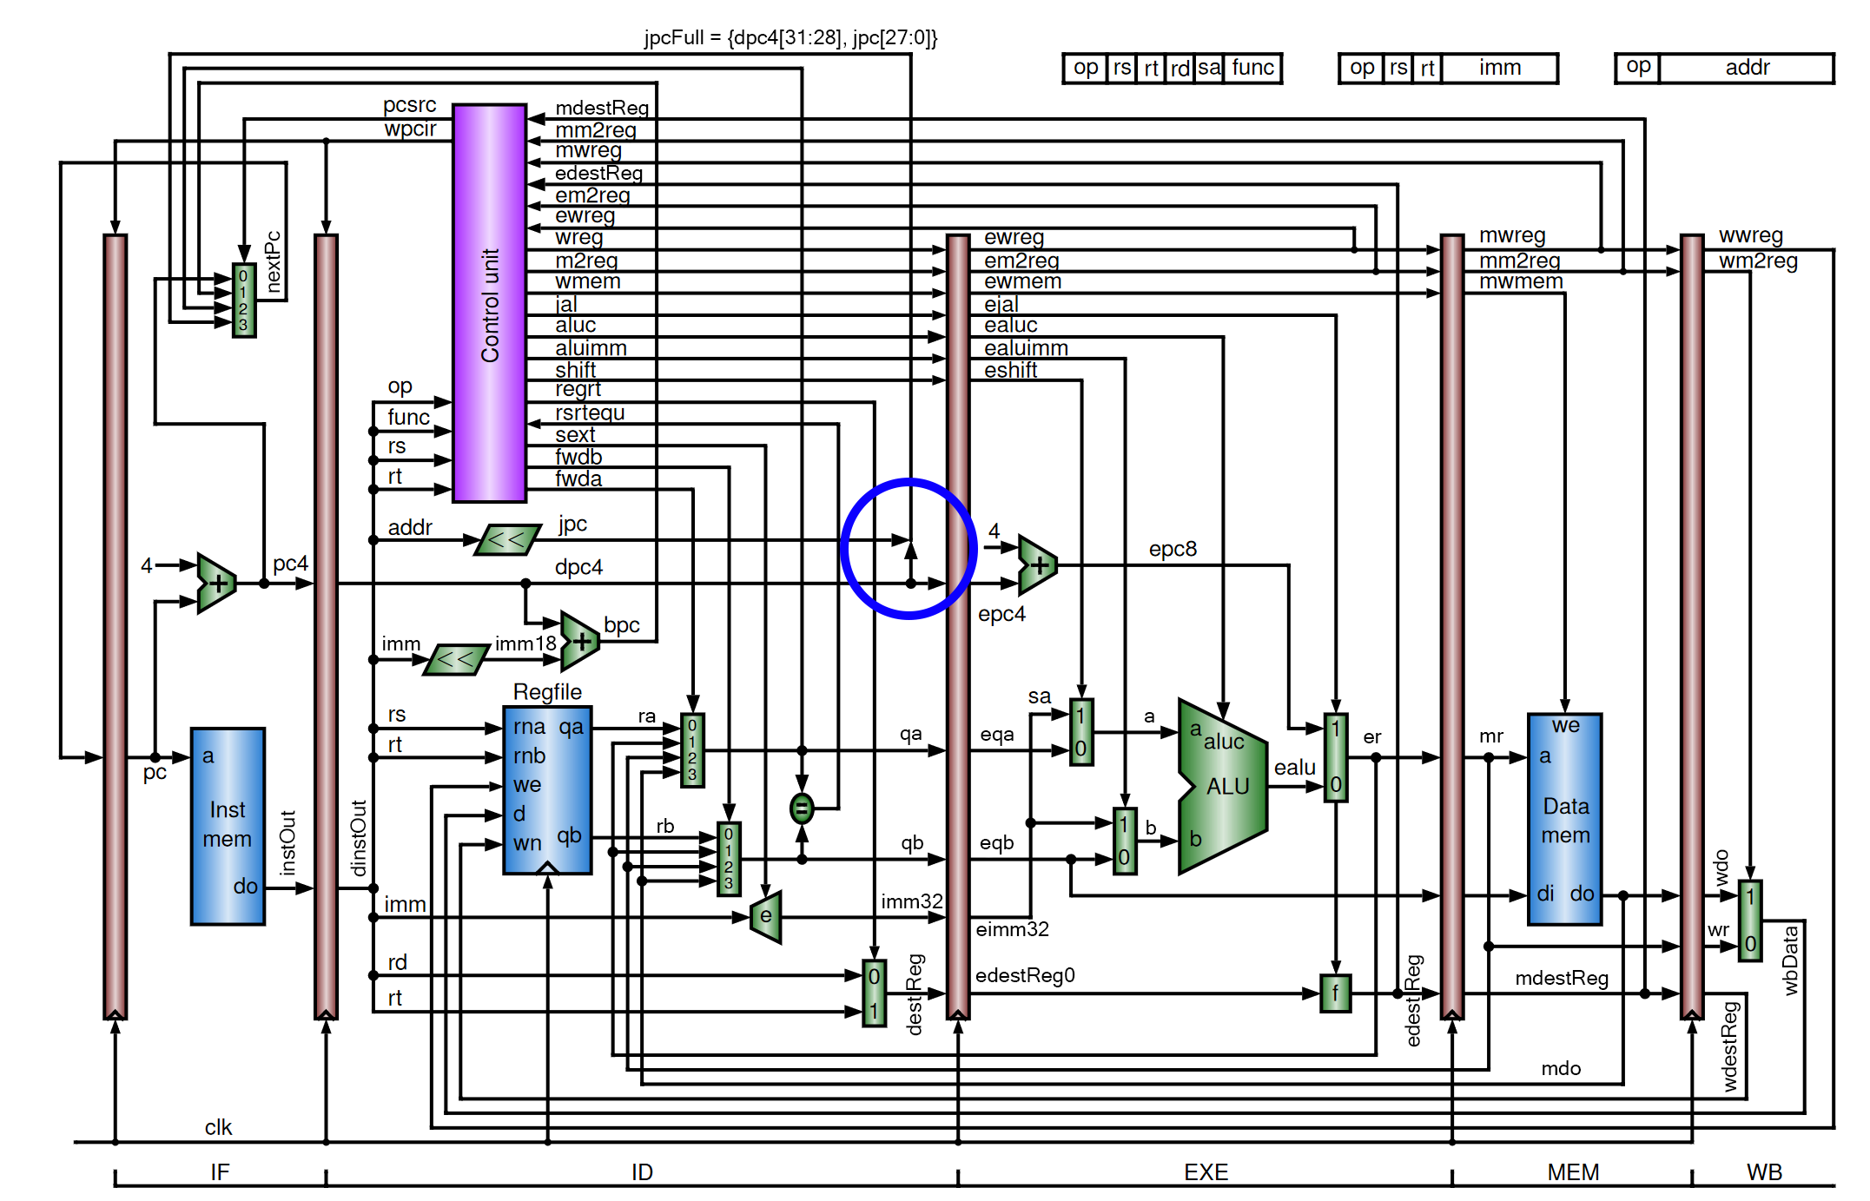
JpcFull signal concatenation
Notes:
One last thing I want to make note of is in the diagram, you have this concatenation in the ID stage. The value of this concatenation will be bits 31 through 28 of dpc4, and bits 27 through 0 of jpc. I called this signal JpcFull in the diagram here, and you can make this concatenation in the datapath, no need to create another module for this.

Slide 16
NEW Final Remarks and Tips
I HIGHLY recommend putting different modules into different files.
Yes, the lab doc tips say that you should put all non-simulation modules into a single file, but I’ve found that students who do use different files for modules spend less time debugging, and have an easier time finding modules when they need to.
Accessing the modules may require an extra menu, but from my experience it’s much faster than scrolling up and down all of your code looking for the correct module.
Format your code.
Proper indentation, formatting, and commenting of your code will make your life much, much easier when you enter the debugging stage of the lab.
Students who don’t format and comment their code tend to spend a lot more time debugging than students who do format and comment.
How you format and comment your code is up to you, do what works best for you.
Remember that you will have to look at the code you write while debugging, not to mention the future labs and final project, so make sure it is easy for you to read and understand what’s going on in your code.
Give everything names that make sense
This fits in with the Format your code section.
The names of your modules, wires, and registers should make it fairly clear what they are used for or what they are trying to represent.
Naming registers reg1, reg2, etc. is ambiguous and will make debugging very difficult.
How you name your modules is completely up to you (with the exception of the testbench), but I recommend using the names within the provided diagrams.
Remember that with the testbench, your wires should very clearly represent what each signal is.
I also recommend defining module names with their intended stage of the pipeline as a prefix
For example, I would define the program counter module as “IF_ProgramCounter” and the regrt multiplexer as “ID_RegrtMux” with IF and ID corresponding to the correct stage of the pipeline.
Again, how you name everything is up to you, do what works best for you.
Notes:
Now, while this is everything you’ll need to know for the final project bonus, I have one extra remark I’d like to make before you go.

Slide 17
NEW Final Remarks and Tips
Start Early!!!
I know I put this tip at the beginning, but I cannot stress enough how important it is to give yourself enough time to complete the labs.
I recommend at minimum starting a week in advance of the due date, this will give you plenty of time to write your code, debug it, and access office hours.
Utilize Office Hours
The office hours of TA’s and LA’s are provided on the syllabus.
TA’s and LA’s will gladly help with all aspects of the lab.
Note: Before asking TA’s and LA’s to debug code, please try and debug it yourself (remember, Follow The Data!)
If you can’t access office hours for whatever reason, you can still email TA’s and LA’s through Canvas or their PSU email and they will help you through there
TA and LA emails are also provided on the syllabus.
Please provide lots of detail about what’s causing you trouble in the lab, screenshots and Verilog code files help greatly with this!
Want to learn/practice more?
If you find you enjoyed this project and the course material, I highly recommend you check out RISC-V
Please complete the final project before you do any of this, this is all extra and not assigned material for the course
RISC-V is a modern, well-documented, open-source instruction set that is very similar to MIPS, with a couple differences that makes it stand out
If you want some extra practice, try creating a new pipeline that can interpret RISC-V instructions
The ISA documentation can be found at https://riscv.org/technical/specifications/
check out the Unprivileged Spec under “ISA Specification” for guidelines on how instructions should execute within the datapath in a RISC-V CPU
There’s a bunch of resources online for RISC-V, so go check it out!
Again, this is all extra and won’t gain you any extra points in the course, just something that you should check out if you find this stuff interesting!
Notes:
If you found that you enjoyed this project and the course material, I highly recommend that you check out RISC-five. You should check out the unprivileged spec under ISA specification, this will lead you to a PDF of all of the guidelines you’ll need to know in order to make a RISC-five CPU. You can check out the privledged spec too if you’re curious as to what you’d need to add in order to make a CPU capable of running something like a linux-based distro. With that, this concludes the video for the final project bonus. Once again, if you need help, the times of office hours are on the syllabus, along with the emails for the TA’s and LA’s. Have a great day, and I hope you enjoy your break after the semester ends!

